Slide 1
Chapter 5: CPU Scheduling

Slide 2
Chapter 5: CPU Scheduling
Basic Concepts
Scheduling Criteria
Scheduling Algorithms
Multiple-Processor Scheduling
Real-Time Scheduling
Thread Scheduling
Operating Systems Examples
Java Thread Scheduling
Algorithm Evaluation

Slide 3
5.1 Basic Concepts
Maximum CPU utilization obtained with multiprogramming
CPU–I/O Burst Cycle – Process execution consists of a cycle of CPU execution and I/O wait
CPU burst distribution
CPU执行期 (CPU Burst Cycle)
I/O执行期 (I/O Burst Cycle)

Slide 4

Alternating Sequence of CPU And I/O Bursts

Slide 5

Histogram of CPU-burst Times
大部分的CPU执行期是比较短的

Slide 6
Basic Concepts
Maximum CPU utilization obtained with multiprogramming
CPU–I/O Burst Cycle – Process execution consists of a cycle of CPU execution and I/O wait
CPU burst distribution
CPU执行期
I/O执行期
抢先 vs. 非抢先式调度
  如果一种CPU调度方式将一个CPU执行期分割成多个CPU执行期，那么这种调度方式就属于抢先式调度（抢占、剥夺）；
  如果一种CPU调度方式仅在一个进程执行完其一个CPU执行期时才引起进程调度，则这种调度方式属于非抢先式调度（非抢占、非剥夺）。

Slide 7
CPU Scheduler
Selects from among the processes in memory that are ready to execute, and allocates the CPU to one of them
CPU scheduling decisions may take place when a process:
  1. Switches from running to waiting state
  2. Switches from running to ready state
  3. Switches from waiting to ready
  4. Terminates
Scheduling under 1 and 4 is nonpreemptive
All other scheduling is preemptive
结合进程状态图

Slide 8
Dispatcher
Dispatcher module gives control of the CPU to the process selected by the short-term scheduler; this involves:
  switching context (in kernal mode)
  switching to user mode
  jumping to the proper location in the user program to restart that program
Dispatch latency – time it takes for the dispatcher to stop one process and start another running

Slide 9
5.2 Scheduling Criteria
CPU utilization – keep the CPU as busy as possible
Throughput – the number of processes that complete their execution per time unit
Turnaround time – amount of time to execute a particular process
  The interval from the time of submission of a process to the time of completion
Waiting time – amount of time a process has been waiting in the ready queue
Response time – amount of time it takes from when a request was submitted until the first response is produced, not output (for time-sharing environment)

Slide 10
Optimization Criteria
Max CPU utilization
Max throughput
Min turnaround time
Min waiting time
Min response time

Slide 11
5.3 Scheduling Algorithms
First-Come, First-Served (FCFS) Scheduling
Shortest-Job-First (SJF) Scheduling
Priority Scheduling
Round-Robin Scheduling
Multilevel Queue Scheduling
Multilevel Feedback-Queue Scheduling

Slide 12
5.3.1 First-Come, First-Served (FCFS) Scheduling
Process Burst Time
P₁ 24
P₂ 3
P₃ 3
Suppose that the processes arrive in the order: P₁ , P₂ , P₃
The Gantt Chart for the schedule is:
Waiting time for P₁ = 0; P₂ = 24; P₃ = 27
Average waiting time: (0 + 24 + 27)/3 = 17
Turnaround time for P₁ = 24; P₂ = 27; P₃ = 30
P₁
P₂
P₃
0
24
27
30

Slide 13
FCFS Scheduling (Cont.)
Suppose that the processes arrive in the order
P₂ , P₃ , P₁
The Gantt chart for the schedule is:
Waiting time for P₁ = 6; P₂ = 0; P₃ = 3
Average waiting time: (6 + 0 + 3)/3 = 3
Much better than previous case
“公平”
Convoy effect short process behind long process
有利于长作业，对短作业不利，系统吞吐量小
进程的到达顺序对调度性能影响很大；
例如原始数据的顺序对quiksort的复杂度的影响 O(n²) or O(nlogn)
P₂
P₃
P₁
0
3
6
30

Slide 14
5.3.2 Shortest-Job-First (SJF) Scheduling
Associate with each process the length of its next CPU burst. Use these lengths to schedule the process with the shortest time
Two schemes:
  nonpreemptive – once CPU given to the process it cannot be preempted until completes its CPU burst
  preemptive – if a new process arrives with CPU burst length less than remaining time of current executing process, preempt. This scheme is know as the
  Shortest-Remaining-Time-First (SRTF)
SJF is optimal – gives minimum average waiting time for a given set of processes

Slide 15
Example of Non-Preemptive SJF
Process Arrival Time Burst Time
P₁ 0.0 7
P₂ 2.0 4
P₃ 4.0 1
P₄ 5.0 4
SJF (non-preemptive)
Average waiting time = (0 + 6 + 3 + 7)/4 = 4
Turnaround time for P₁ = 7; P₂ = 12-2; P₃ = 8-4; P₄ = 16-5
P₁
P₃
P₂
P₄
0
3
7
8
12
16

Slide 16
Example of Preemptive SJF
Process Arrival Time Burst Time
P₁ 0.0 7
P₂ 2.0 4
P₃ 4.0 1
P₄ 5.0 4
SJF (preemptive)
Average waiting time = (9 + 1 + 0 +2)/4 = 3
P₁
P₂
P₃
P₂
P₄
P₁
0
2
4
5
7
11
16

Slide 17


Determining Length of Next CPU Burst
Can only estimate the length
Can be done by using the length of previous CPU bursts, using exponential averaging

Slide 18

Prediction of the Length of the Next CPU Burst

Slide 19
Examples of Exponential Averaging
α =0
  τ_{n+1} = τ_{n}
  Recent history does not count
α =1
  τ_{n+1} = α t_{n}
  Only the actual last CPU burst counts
If we expand the formula, we get:
    τ_{n+1} = α t_{n}+(1 - α)α t_{n} -1 + …
    +(1 - α )^{j} α t_{n} _{-j} + …
    +(1 - α )^{n +1} τ₀
Since both α and (1 - α) are less than or equal to 1, each successive term has less weight than its predecessor

Slide 20
SJF
系统吞吐量大，平均周转时间短
有利于短作业，不利于长作业
如果采用抢先式调度，下一个CPU周期的长度无法精确获得，只能采用预测的方法
Starvation –processes with long next CPU burst may never execute.

Slide 21
5.3.3 Priority Scheduling
A priority number (integer) is associated with each process
The CPU is allocated to the process with the highest priority (smallest integer ≡ highest priority)
Priorities can be defined either
  internally
    Use some measurable quantity or quantities to compute the priorities: time limits, memory requirements, the number of open files, and the ratio of average I/O burst to average CPU burst
  externally
    Set by criteria outside the operating system, such as the importance of process, type and amount of funds being paid for computer use, department sponsoring the work, and other, often political factors.
Priority Scheduling can be either
  Preemptive
  Non-preemptive

Slide 22
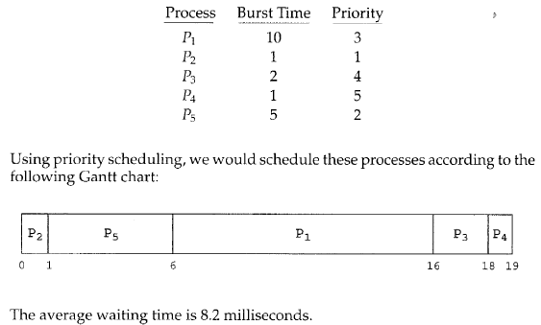
Priority Scheduling(Cont.)
average waiting time=(6+0+16+18+1)/5=41/5=8.2
Non-preemptive

Slide 23
Priority Scheduling(Cont.)
SJF is a priority scheduling where priority is the predicted next CPU burst time
Problem ≡ Starvation – low priority processes may never execute
Solution ≡ Aging – as time progresses increase the priority of the process
Indefinite blocking (Starvation)--a process that is ready to run but waiting for CPU can be considered blocked.
When the IBM 7049 at MIT was shut down in 1973,a low-priority process submitted in 1967 had not yet been run.

Slide 24
5.3.4 Round Robin (RR)
For time-sharing system
Ready queue -FCFS
Each process gets a small unit of CPU time (time quantum), usually 10-100 milliseconds. After this time has elapsed, the process is preempted and added to the end of the ready queue.
If there are n processes in the ready queue and the time quantum is q, then each process gets 1/n of the CPU time in chunks of at most q time units at once. No process waits more than (n-1)q time units.
Performance
  q large ⇒ FIFO
  q small ⇒ q must be large with respect to context switch, otherwise overhead is too high

Slide 25
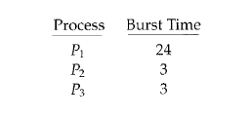

Example of RR with Time Quantum = 4
average waiting time=[(30-24)+(7-3)+(10-3))]/3=17/3=5.66

Slide 26
Example of RR with Time Quantum = 20
Process Burst Time
P₁ 53
P₂ 17
P₃ 68
P₄ 24
The Gantt chart is:
average waiting time=[(134-53)+(37-17)+(162-68))+(121-24)]/5=?
Typically, higher average turnaround than SJF, but better response
P₁
P₂
P₃
P₄
P₁
P₃
P₄
P₁
P₃
P₃
0
20
37
57
77
97
117
121
134
154
162

Slide 27

Time Quantum and Context Switch Time

Slide 28

Turnaround Time Varies With The Time Quantum

Slide 29
5.3.5 Multilevel Queue
Ready queue is partitioned into separate queues:
  foreground (interactive)
  background (batch)
Each queue has its own scheduling algorithm
  foreground – RR
  background – FCFS
Scheduling must be done between the queues
  Fixed priority scheduling; (i.e., serve all from foreground then from background). Possibility of starvation.
  Time slice – each queue gets a certain amount of CPU time which it can schedule amongst its processes; i.e.,
      80% to foreground in RR
      20% to background in FCFS

Slide 30

Multilevel Queue Scheduling

Slide 31
5.3.6 Multilevel Feedback Queue
A process can move between the various queues; aging can be implemented this way
Multilevel-feedback-queue scheduler defined by the following parameters:
  number of queues
  scheduling algorithms for each queue
  method used to determine when to upgrade a process
  method used to determine when to demote a process
  method used to determine which queue a process will enter when that process needs service

Slide 32

Multilevel Feedback Queues (Cont.)

Slide 33
Example of Multilevel Feedback Queue
Three queues:
  Q₀ – RR with time quantum 8 milliseconds
  Q₁ – RR time quantum 16 milliseconds
  Q₂ – FCFS
Scheduling
  A new job enters queue Q₀ which is served FCFS. When it gains CPU, job receives 8 milliseconds. If it does not finish in 8 milliseconds, job is moved to queue Q₁.
  At Q₁ job is again served FCFS and receives 16 additional milliseconds. If it still does not complete, it is preempted and moved to queue Q₂.

Slide 34
Example Multilevel Feedback Queues
average waiting tim=?

Slide 35
5.4 Multiple-Processor Scheduling
CPU scheduling more complex when multiple CPUs are available
Homogeneous processors within a multiprocessor
Load sharing
Asymmetric multiprocessing (ASMP)–one processor is responsible for all scheduling decisions, I/O processing, and other system activities (master server), the others execute only use code
  simple
  only one processor accesses the system data structures, alleviating the need for data sharing
Symmetric multiprocessing (SMP)–all processor is responsible for all scheduling decisions, I/O processing, and other system activities
  complex

Slide 36
Symmetric Multithreading(SMT)
Also called hyperthreading tecnology (on Intel processor)
SMP-multiple physical processors;
SMT-multiple logical processors;
  Presenting a view of several logical processors to the operating system.
  Create multiple logic processors on the same physical processors;

Slide 37
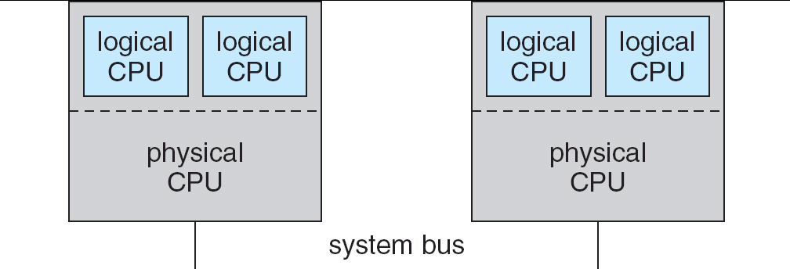
A typical SMT architecture
Figure 5.8 A typical SMT architecture

Slide 38
Real-Time Scheduling
Hard real-time systems – required to complete a critical task within a guaranteed amount of time
Soft real-time computing – requires that critical processes receive priority over less fortunate ones

Slide 39
5.5 Thread Scheduling
Local Scheduling – How the threads library decides which thread to put onto an available LWP
  User-level threads must ultimately be mapped to an associated kernel-level threads.
Global Scheduling – How the kernel decides which kernel thread to run next
e.g.
  客户之间如何决定谁先得到银行职员提供的服务
  银行仅提供一个服务窗口，银行职员之间如何共享该窗口

Slide 40
Pthread Scheduling API
#include <pthread.h>
#include <stdio.h>
#define NUM THREADS 5
int main(int argc, char *argv[])
{
int i;
pthread t tid[NUM THREADS];
pthread attr_t attr;
/* get the default attributes */
pthread attr init(&attr);
/* set the scheduling algorithm to PROCESS or SYSTEM */
pthread attr setscope(&attr, PTHREAD_SCOPE_SYSTEM); //PTHREAD_SCOPE_PROCESS
/* set the scheduling policy - FIFO, RT, or OTHER */
pthread attr setschedpolicy(&attr, SCHED_OTHER);
/* create the threads */
for (i = 0; i < NUM THREADS; i++)
pthread create(&tid[i],&attr,runner,NULL);

Slide 41
Pthread Scheduling API
/* now join on each thread */
for (i = 0; i < NUM THREADS; i++)
pthread join(tid[i], NULL);
}
/* Each thread will begin control in this function */
void *runner(void *param)
{
printf("I am a thread\n");
pthread exit(0);
}

Slide 42
5.6 Operating System Examples
Solaris scheduling
Windows XP scheduling
Linux scheduling

Slide 43
Operating System Examples
Solaris scheduling
  Multilevel feedback queue
  Priority-based, preemptive (RR) thread scheduling algorithm

Slide 44
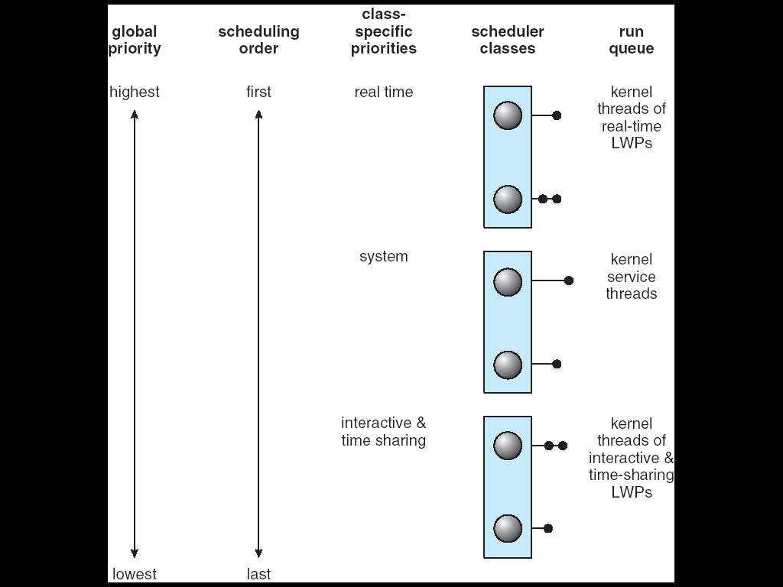
Solaris 2 Scheduling

Slide 45

Solaris Dispatch Table
■ A higher number indicates a higher priority;
■ The higher the priority, the smaller the time slice, and vice versa;
■ When a thread has used its entire time quantum without blocking (CPU intensive), its priority will be lowered;
■ When a thread returns from sleeping, its priority will be boosted;

Slide 46
Operating System Examples
Windows XP scheduling
  Priority-based, preemptive thread scheduling algorithm
  Multilevel feedback queue
  To ensure the highest-priority thread will always run
  A thread selected by the dispatcher will run until
    Preempted by a higher-priority thread
    Terminates
    Time quantum ends
    Calls a blocking system call

Slide 47

Windows XP Priorities
Priority
class
The priority of each thread is based on the priority class it belongs to and its relative priority within the class.
Relative
priority

Slide 48
Linux Scheduling
Two algorithms: time-sharing and real-time
Time-sharing
  Prioritized credit-based – process with most credits is scheduled next
  Credit subtracted when timer interrupt occurs
  When credit = 0, another process chosen
  When all processes have credit = 0, recrediting occurs
    Based on factors including priority and history
Real-time
  Soft real-time
  Posix.1b compliant – two classes
    FCFS and RR
    Highest priority process always runs first

Slide 49

The Relationship Between Priorities and Time-slice length

Slide 50

List of Tasks Indexed According to Prorities

Slide 51
5.7 Algorithm Evaluation
Deterministic modeling – takes a particular predetermined workload and defines the performance of each algorithm for that workload
Queuing models
Simulation
Implementation

Slide 52

5.15

Slide 53
Java Thread Scheduling
JVM Uses a Preemptive, Priority-Based Scheduling Algorithm
FIFO queue is used if there are multiple threads with the same priority

Slide 54
Java Thread Scheduling (cont)
JVM Schedules a Thread to Run When:
  The Currently Running Thread Exits the Runnable State
  A Higher Priority Thread Enters the Runnable State
* Note – the JVM Does Not Specify Whether Threads are Time-Sliced or Not

Slide 55
Time-Slicing
Since the JVM Doesn’t Ensure Time-Slicing, the yield() Method
May Be Used:
while (true) {
// perform CPU-intensive task
. . .
Thread.yield();
}
This Yields Control to Another Thread of Equal Priority

Slide 56
Thread Priorities
Priority Comment
Thread.MIN_PRIORITY Minimum Thread Priority
Thread.MAX_PRIORITY Maximum Thread Priority
Thread.NORM_PRIORITY Default Thread Priority
Priorities May Be Set Using setPriority() method:
setPriority(Thread.NORM_PRIORITY + 2);

Slide 57
Homework
Page 186
4, 5,10
starvation
抢(先)占式调度与非抢占(先)式调度；结合进程状态转换图说明哪些状态的转换可引起非抢先式调度？哪些状态的转换可导致抢先式调度？
各调度算法的基本思想、优点及缺点；
调度算法中相应的计算(如平均等待时间等)
各调度算法存在的主要问题，如何解决？

Slide 58
End of Chapter 5

Slide 59

In-5.7

Slide 60
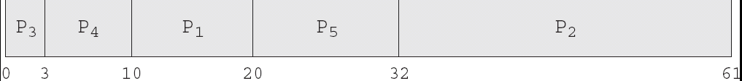
In-5.8

Slide 61

In-5.9

Slide 62

Dispatch Latency

